Slide 1

HOME AUTOMATION SYSTEM
IOT CHALLENGE 2023
TEAM VIKINGS
Trần Văn Thịnh Trịnh Thị Cúc Lê Hùng Việt

Slide 2
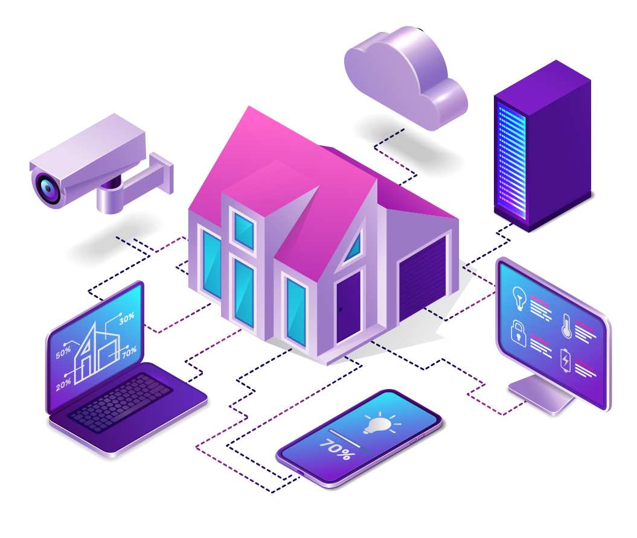
INTRODUCTION
What is Smart Home?

Slide 3
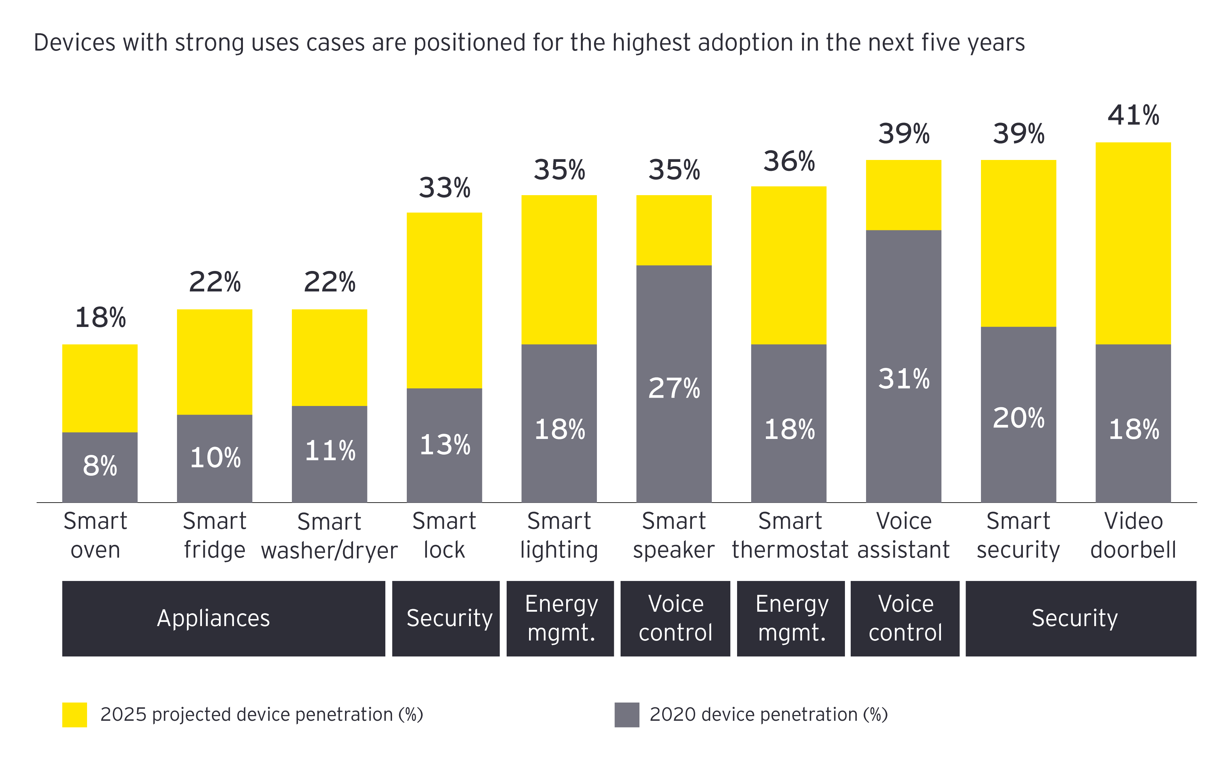
INTRODUCTION
Smart
Home
Trend

Slide 4

CONTENTS
Idea & Solution
Development Process
Demo & Result
Assessment & Conclusion

Slide 5
IDEA
Home Automation System
Intelligent system, capable of remote monitoring and control via Internet
Compact, fully-feature modular product
Easy to install, setup and maintain
User can self-configure basic setting

Slide 6

FEATURES
Monitor environmental parameters and notify of irregularities
Facial recognition lock and intrusion alert
Light control with web app, scheduling, automation & switches
Monitor electric devices: power, fault detection
Collect and store data, visualize with chart

Slide 7
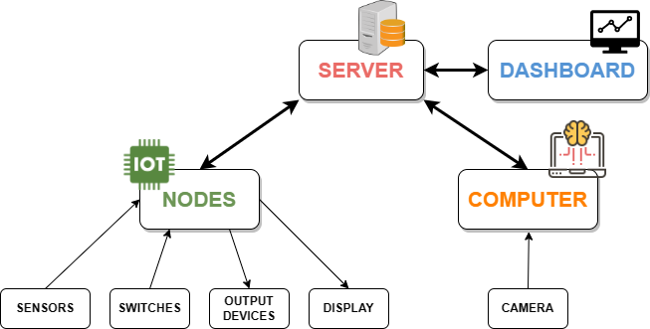
SYSTEM OVERVIEW

Slide 8





DEVELOPMENT PROCESS
May
July
September
Idea &
Preliminary round
Dasboard & sync data
Debug
Compents Assembly, MCU programming, install server
Facial recognition
& Model
June
August

Slide 9
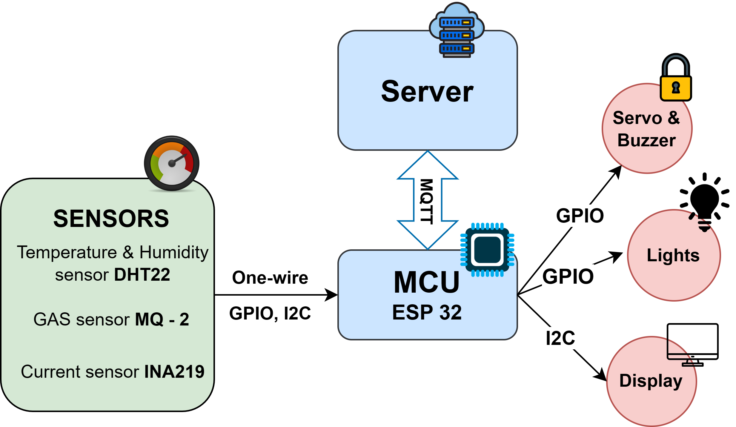
DEVICE

Slide 10

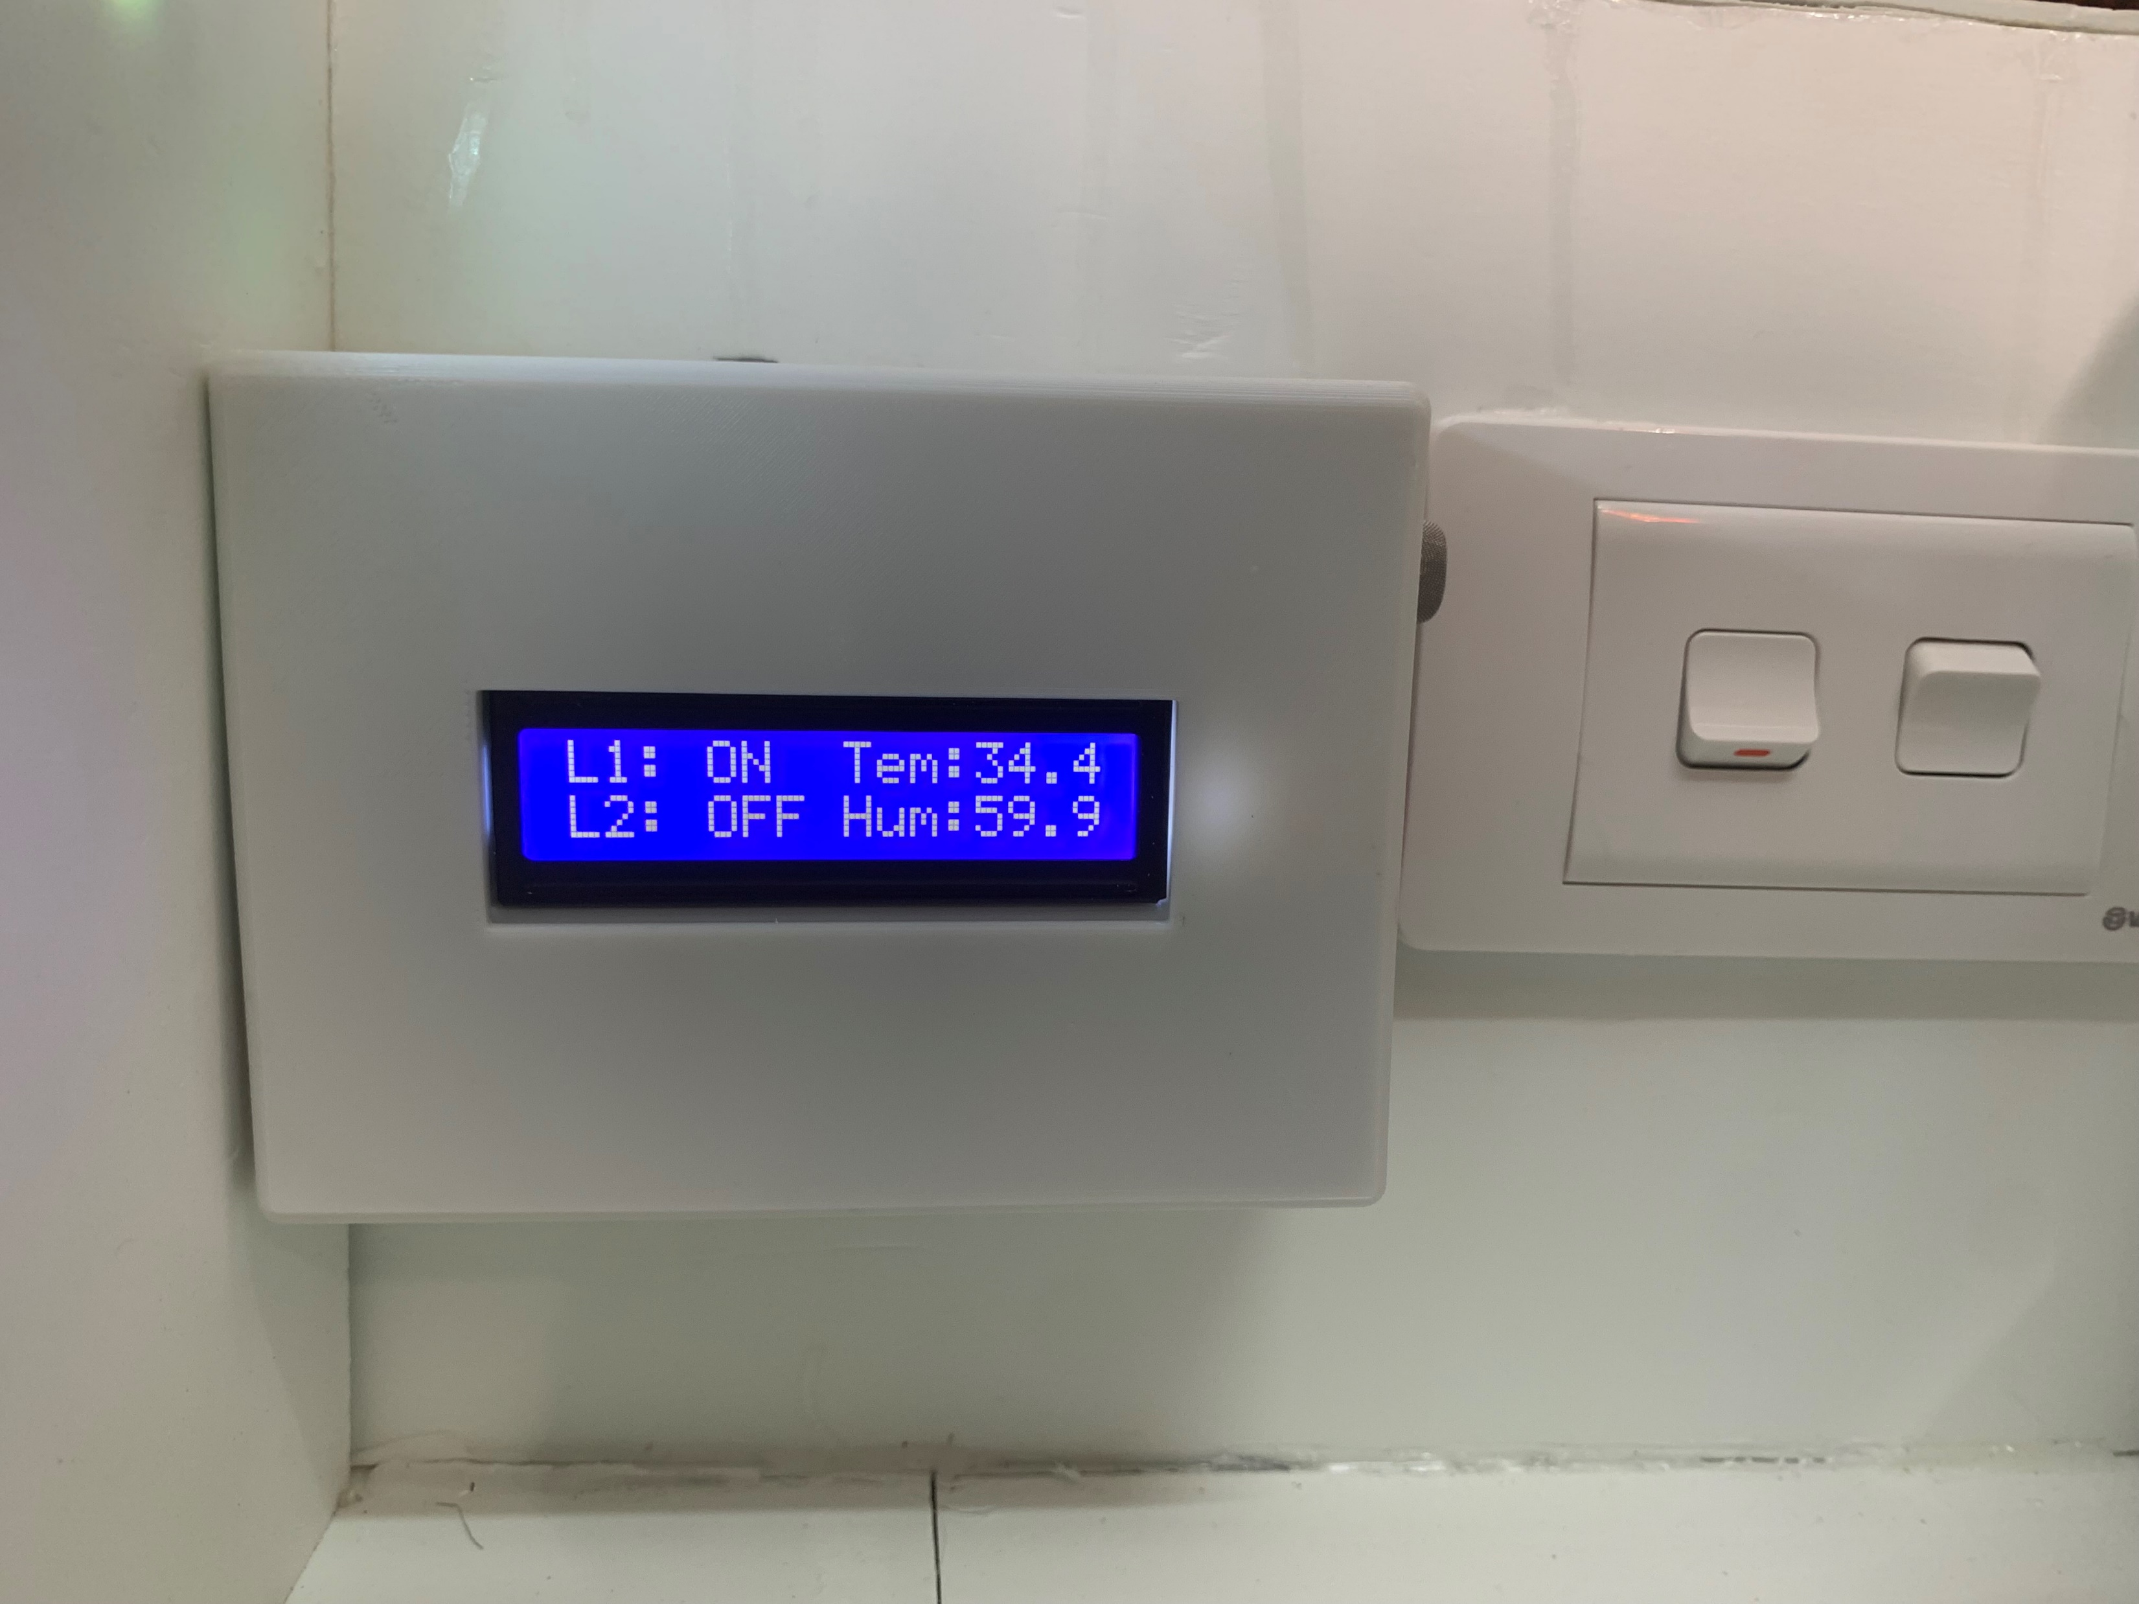
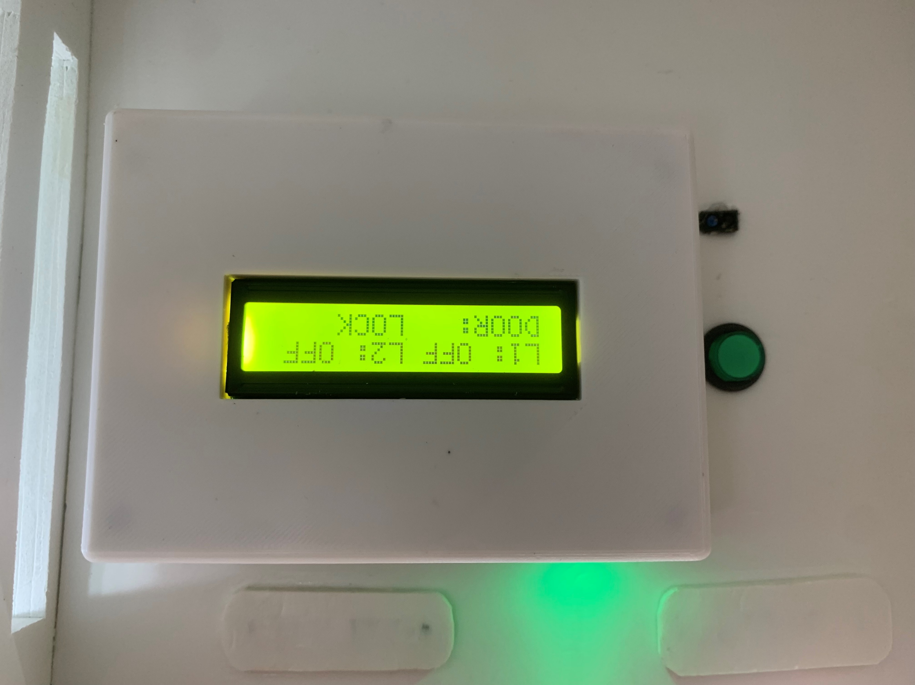
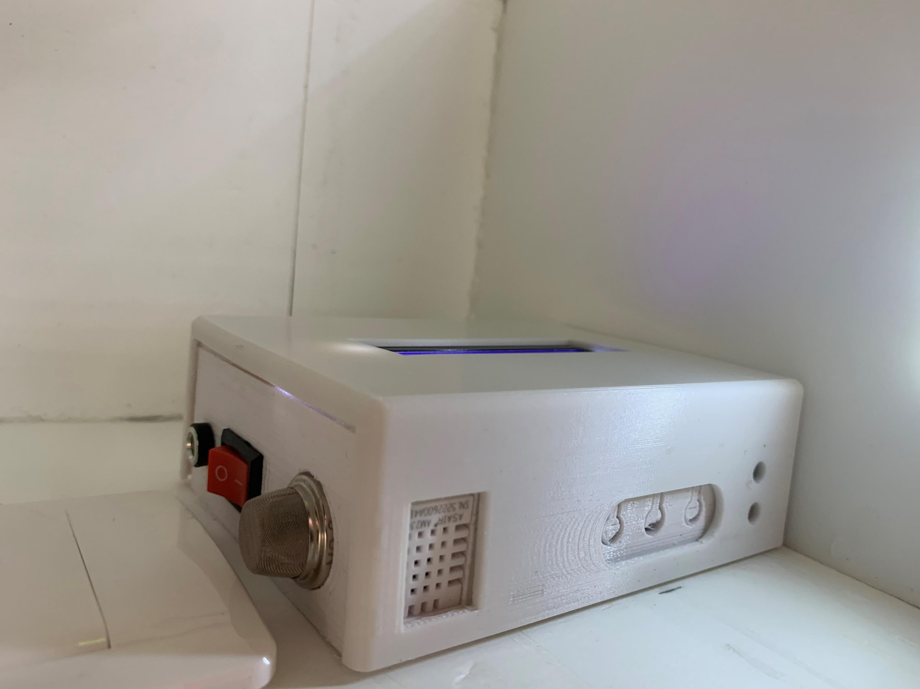
DEVICE
Size 12x9x4 cm
Capacity: up to 220V – 500W

Slide 11
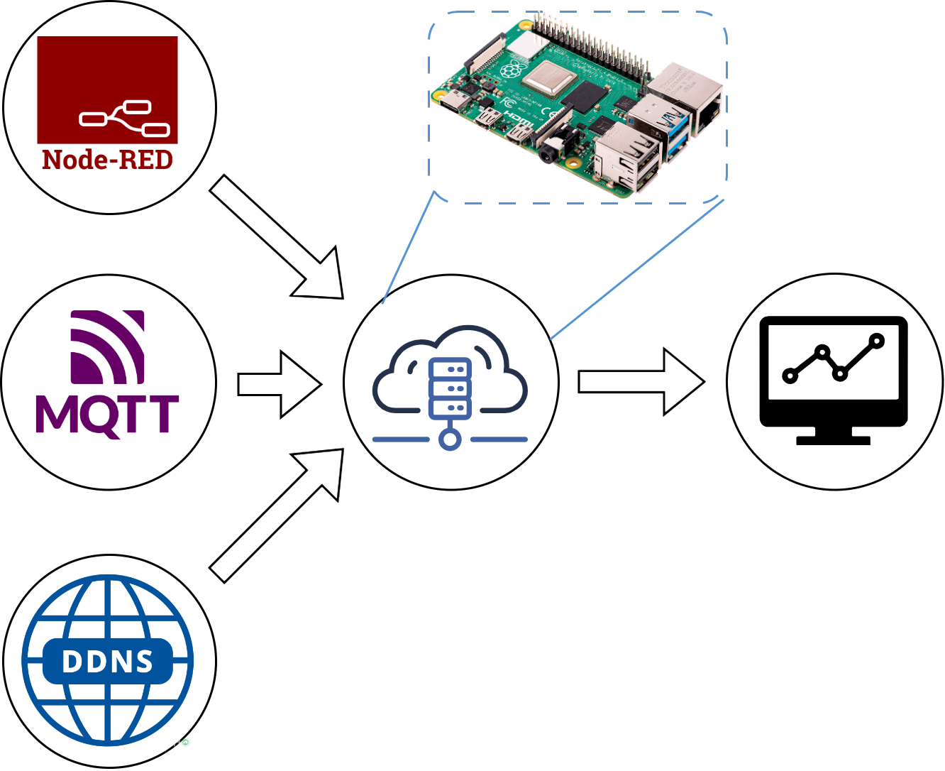
SERVER

Slide 12
DASHBOARD
Visualize environmental parameters
Control devices and monitor their real-time status
User management
Store and manage data

Slide 13
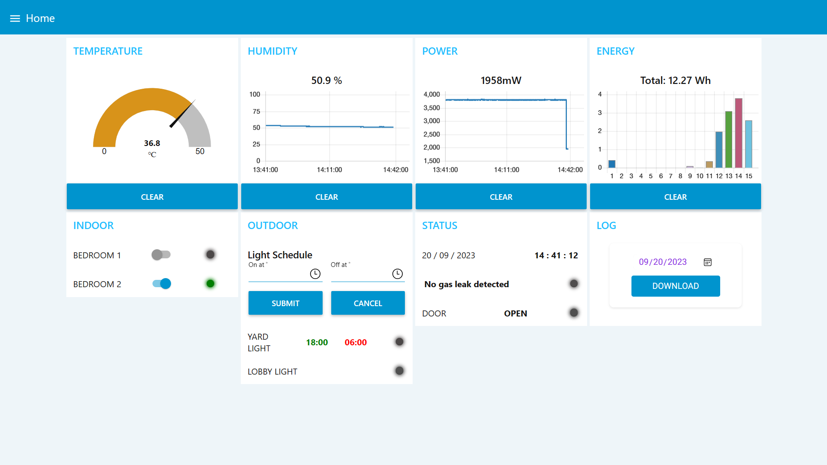

Slide 14
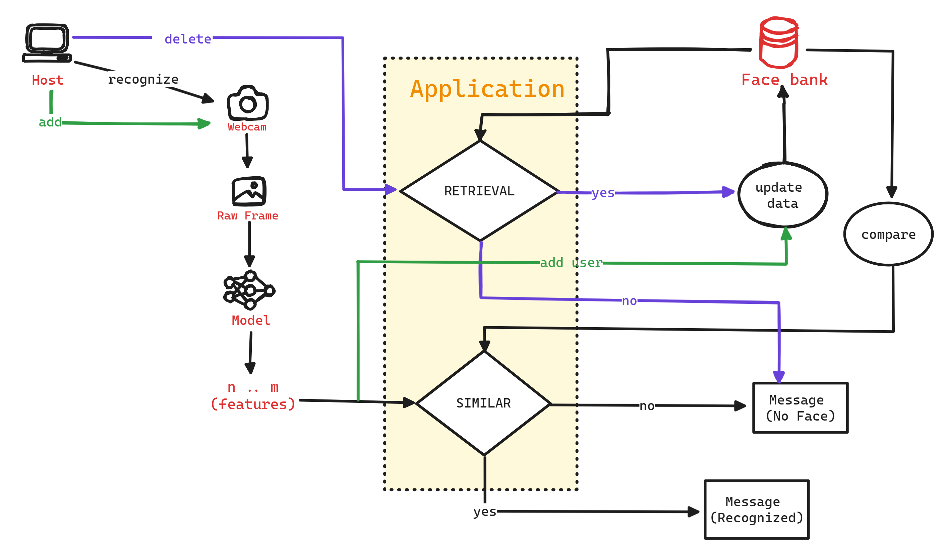
FACIAL RECOGNITION

Slide 15
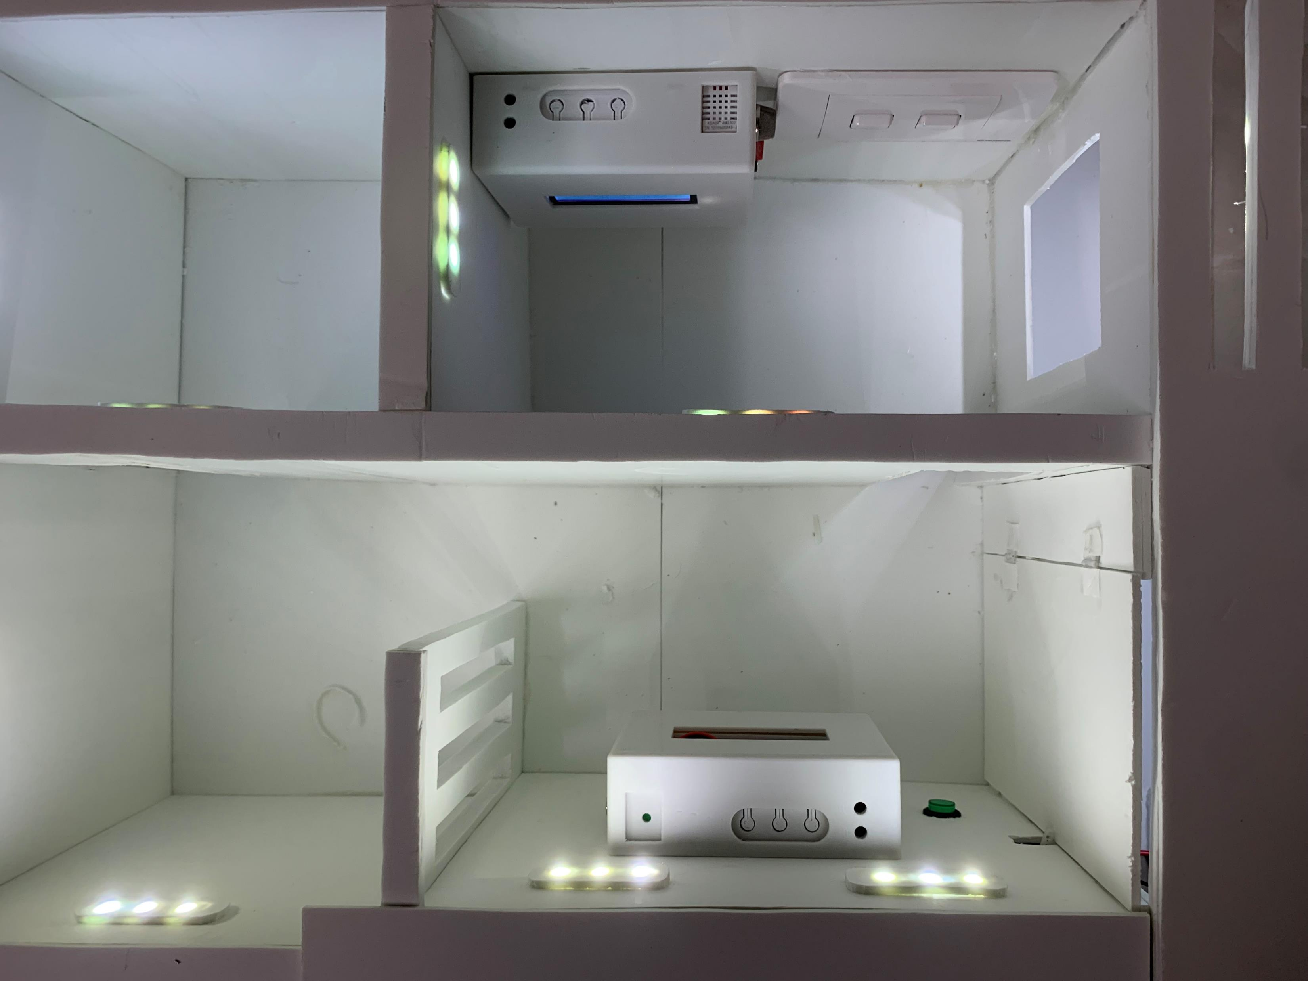
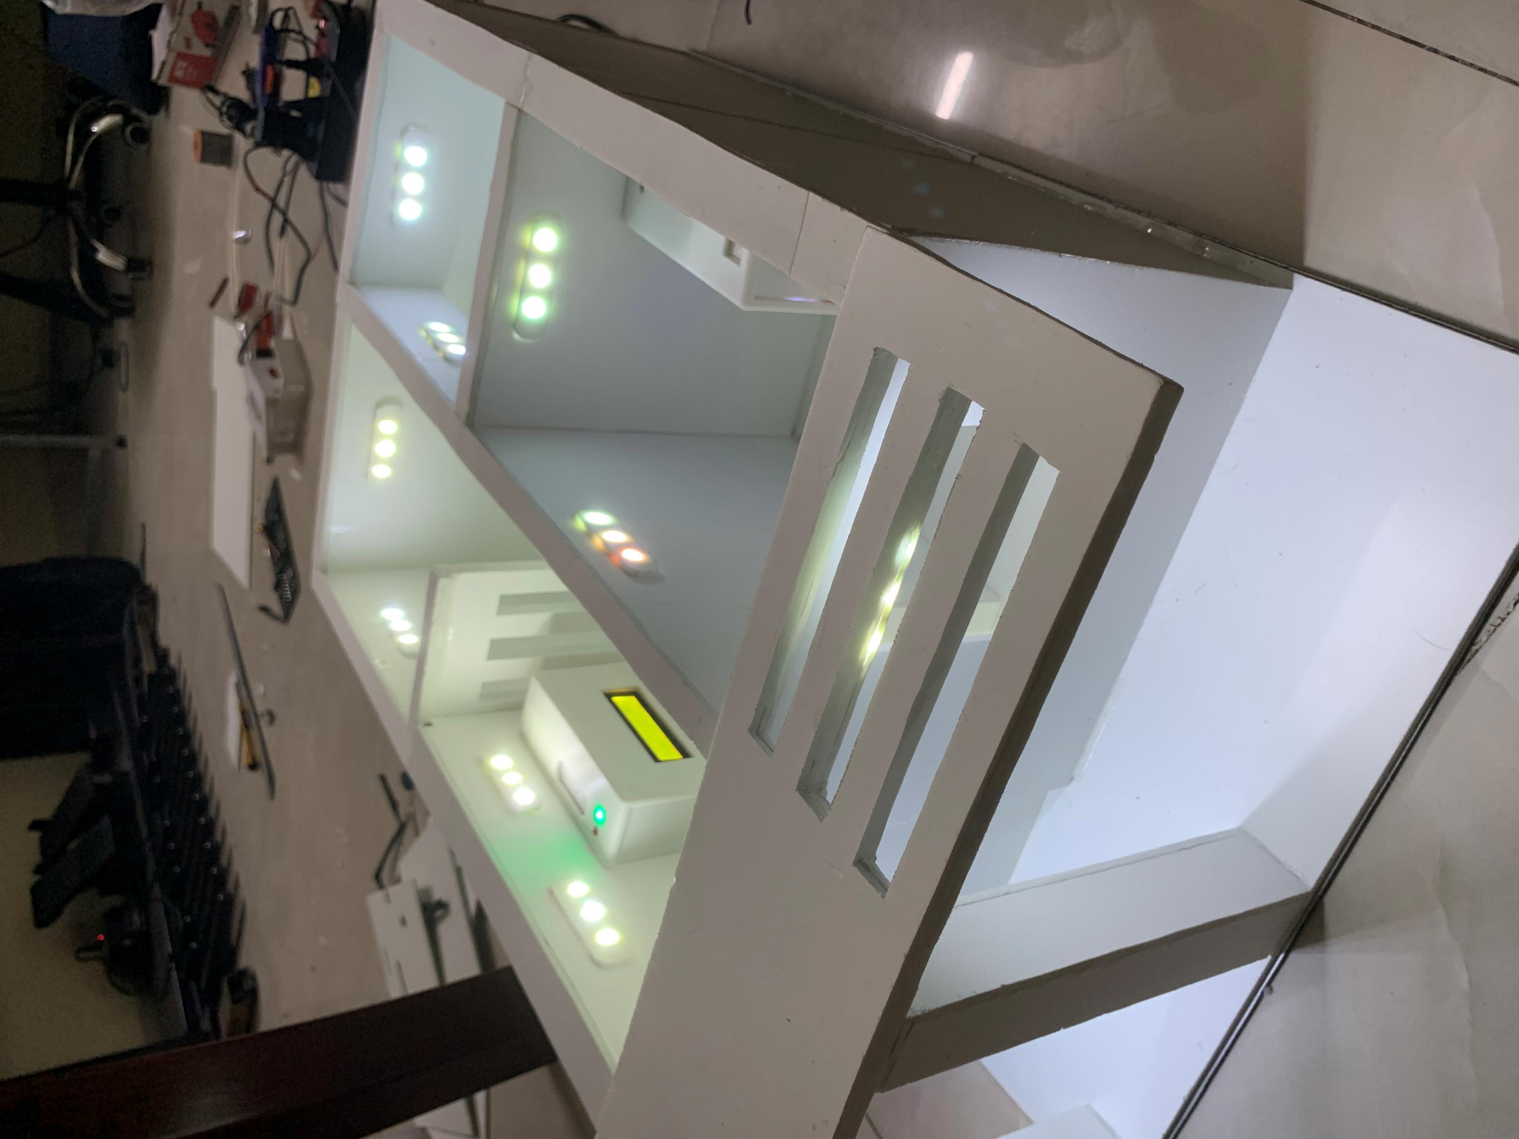

RESULT

Slide 16
Summary
Comprehensive IoT system for smart home
The system meets the specified criteria
Compatible with or replace standard household outlets
Easy of use and management
Facial recognition accuracy reaches 98%

Slide 17


Slide 18
HOME AUTOMATION SYSTEM
IOT CHALLENGE 2023
TEAM VIKINGS
Trần Văn Thịnh Trịnh Thị Cúc Lê Hùng Việt

